Slide 1

Урок вот-вот начнется.
Приготовься, сейчас будет что-то новенькое!

Slide 2


Jenkins
Basics

Slide 3

What is Jenkins

Slide 4

What is Continuous Integration?
Continuous Integration is a development practice in which developers are required to commit changes to source code in a shared repository several times a day. Every commit is then build and this allows the teams to detect problems early.
Devops.Course

Slide 5
What is Continuous Integration?
It then bring following benefits to software development:
Catch issues fast and nip them in the bud.
Everyone can see what’s happening.
Automate the build.
Continuous Integration leads to Continuous Deployment allowing us to deliver software more rapidly.
Devops.Course

Slide 6
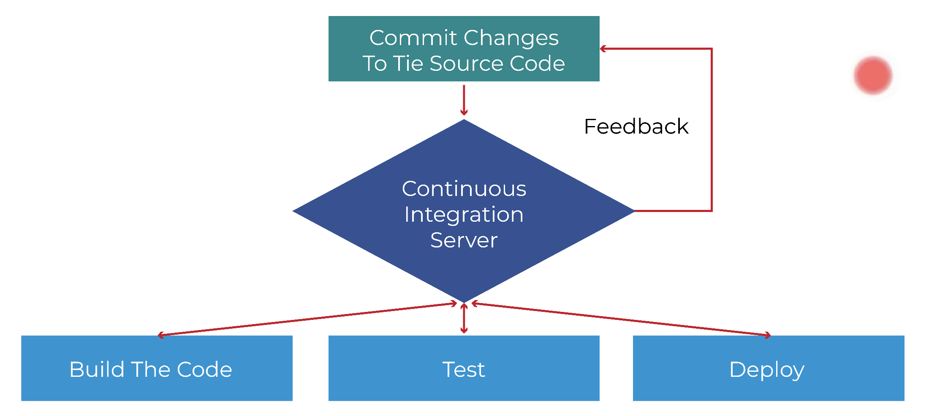
What is Continuous Integration?

Slide 7
What is Continuous Integration?
“Continuous Integration doesn’t get rid of bugs, but it does make them dramatically easier to find and remove.” - Martin Fowler, chief scientist, ThoughtWorks.
Jenkins is just a framework, it achieves Continuous Integration by the help of Plugins. It provides support for over 1000 Plugins.

Slide 8
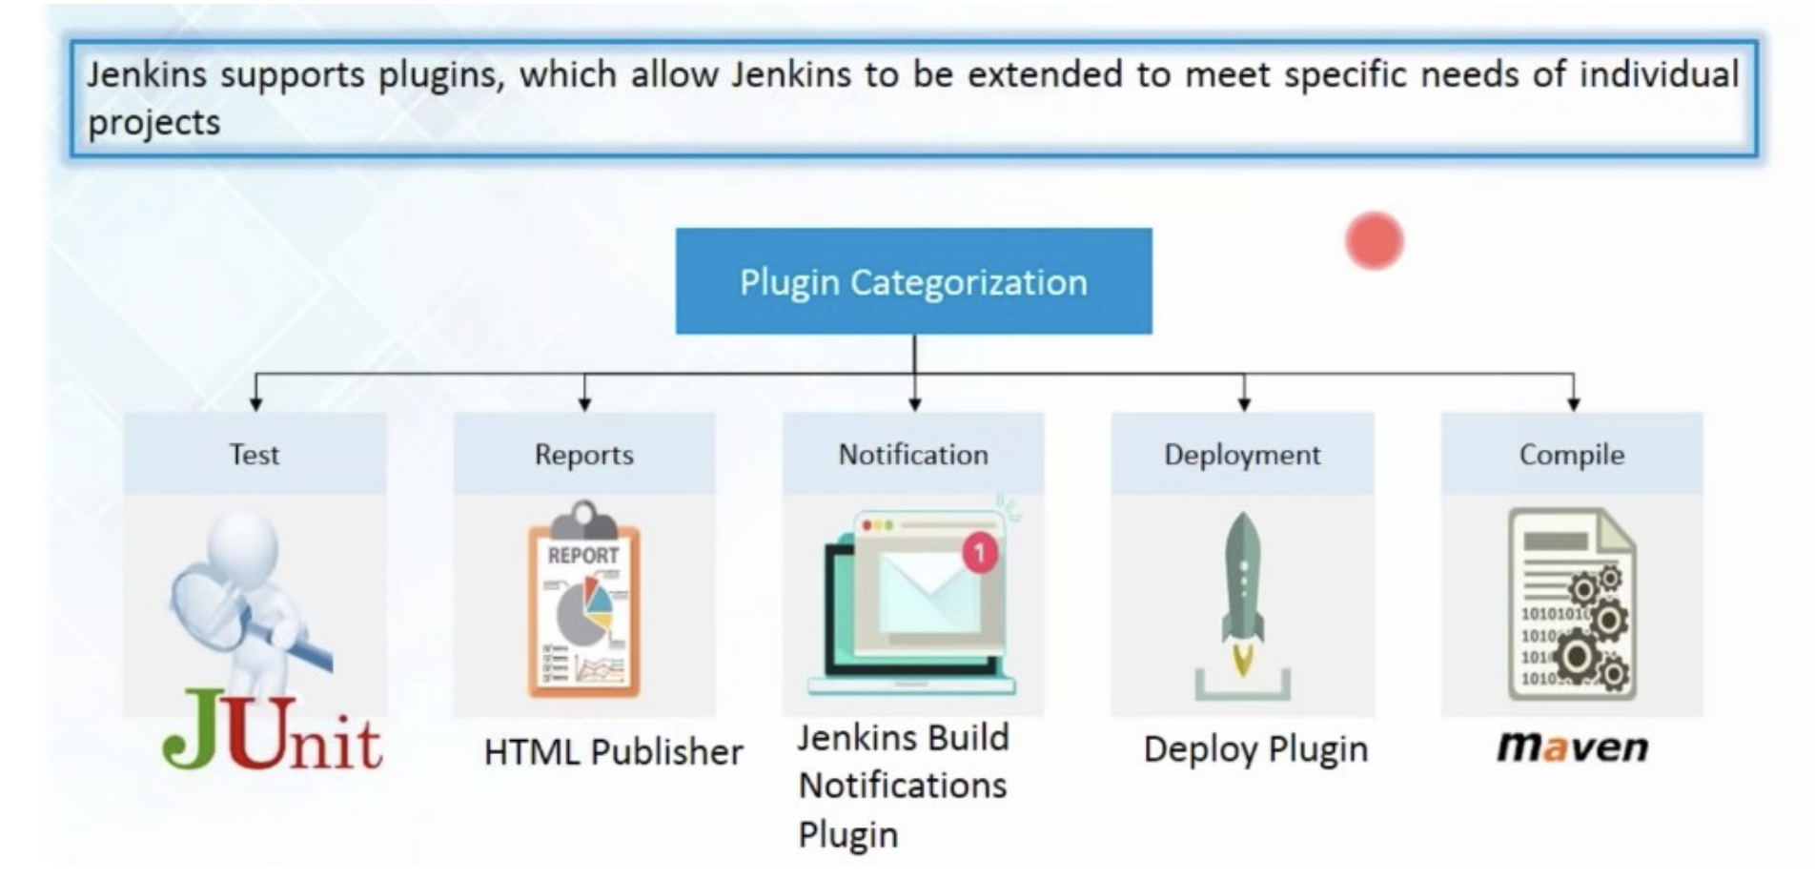
What is Continuous Integration?

Slide 9

Installing and Configuring Jenkins...

Slide 10
Creating a job in Jenkins
To create a new build job in Jenkins: from the Jenkins Dashboard, Click on “New Item”, Name your project and select project type.
Next step: setup configurations
Configuring Global Tool Configuration. Here you can set JDK path, git configurations.
Creating or updating (if already created during project creation) project configuration settings which may include General settings, Source code management, build triggers, Pre-steps, Build, Post Steps, Emailing notification regarding build and post build actions as per your project need.

Slide 11

Security
Devops.Course

Slide 12

Pipeline
Devops.Course

Slide 13
Jenkins file

Slide 14
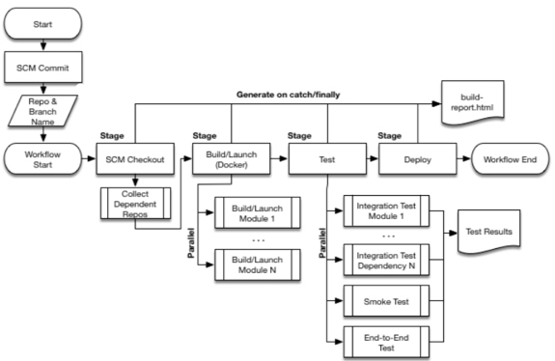
Stages

Slide 15
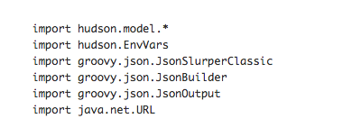
Imports

Slide 16
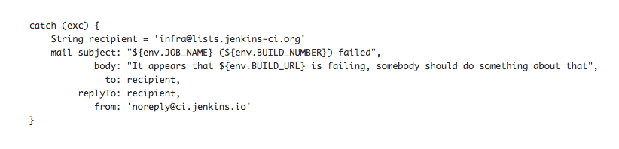
If something goes wrong

Slide 17
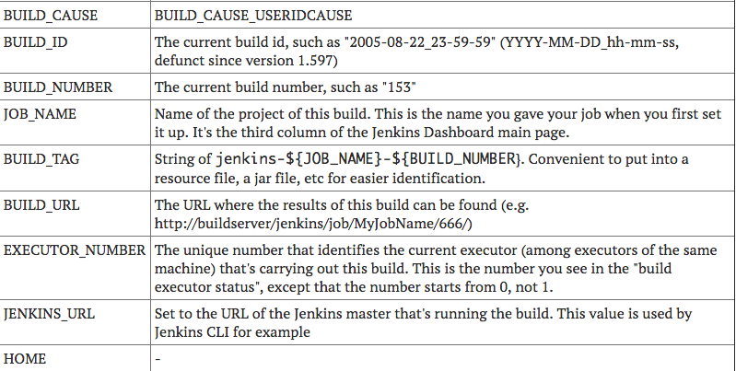
Environment variables

Slide 18
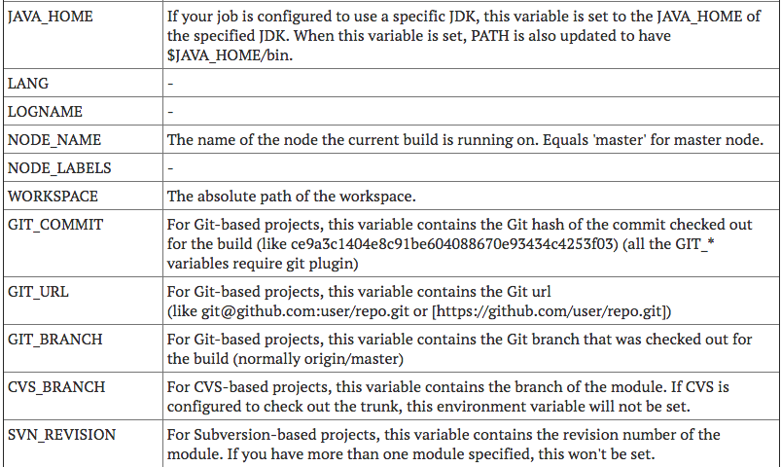
Environment variables

Slide 19
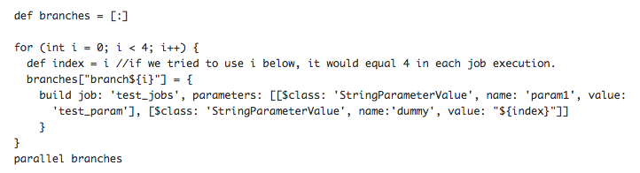
Parallel Jobs

Slide 20
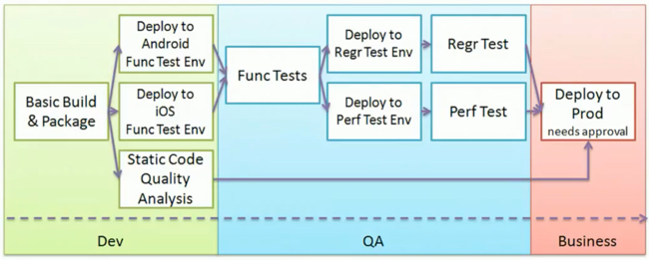
Chaining in the Pipeline

Slide 21
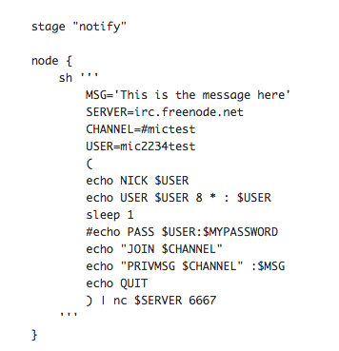
Notification

Slide 22


Questions ?

Slide 23

Thanks for attention!

